Slide 1
Decision Tree
1 Definition
2 Solved equation
3 Geometrical Representation
4 Where to use?
5 Code Implementation

Slide 2
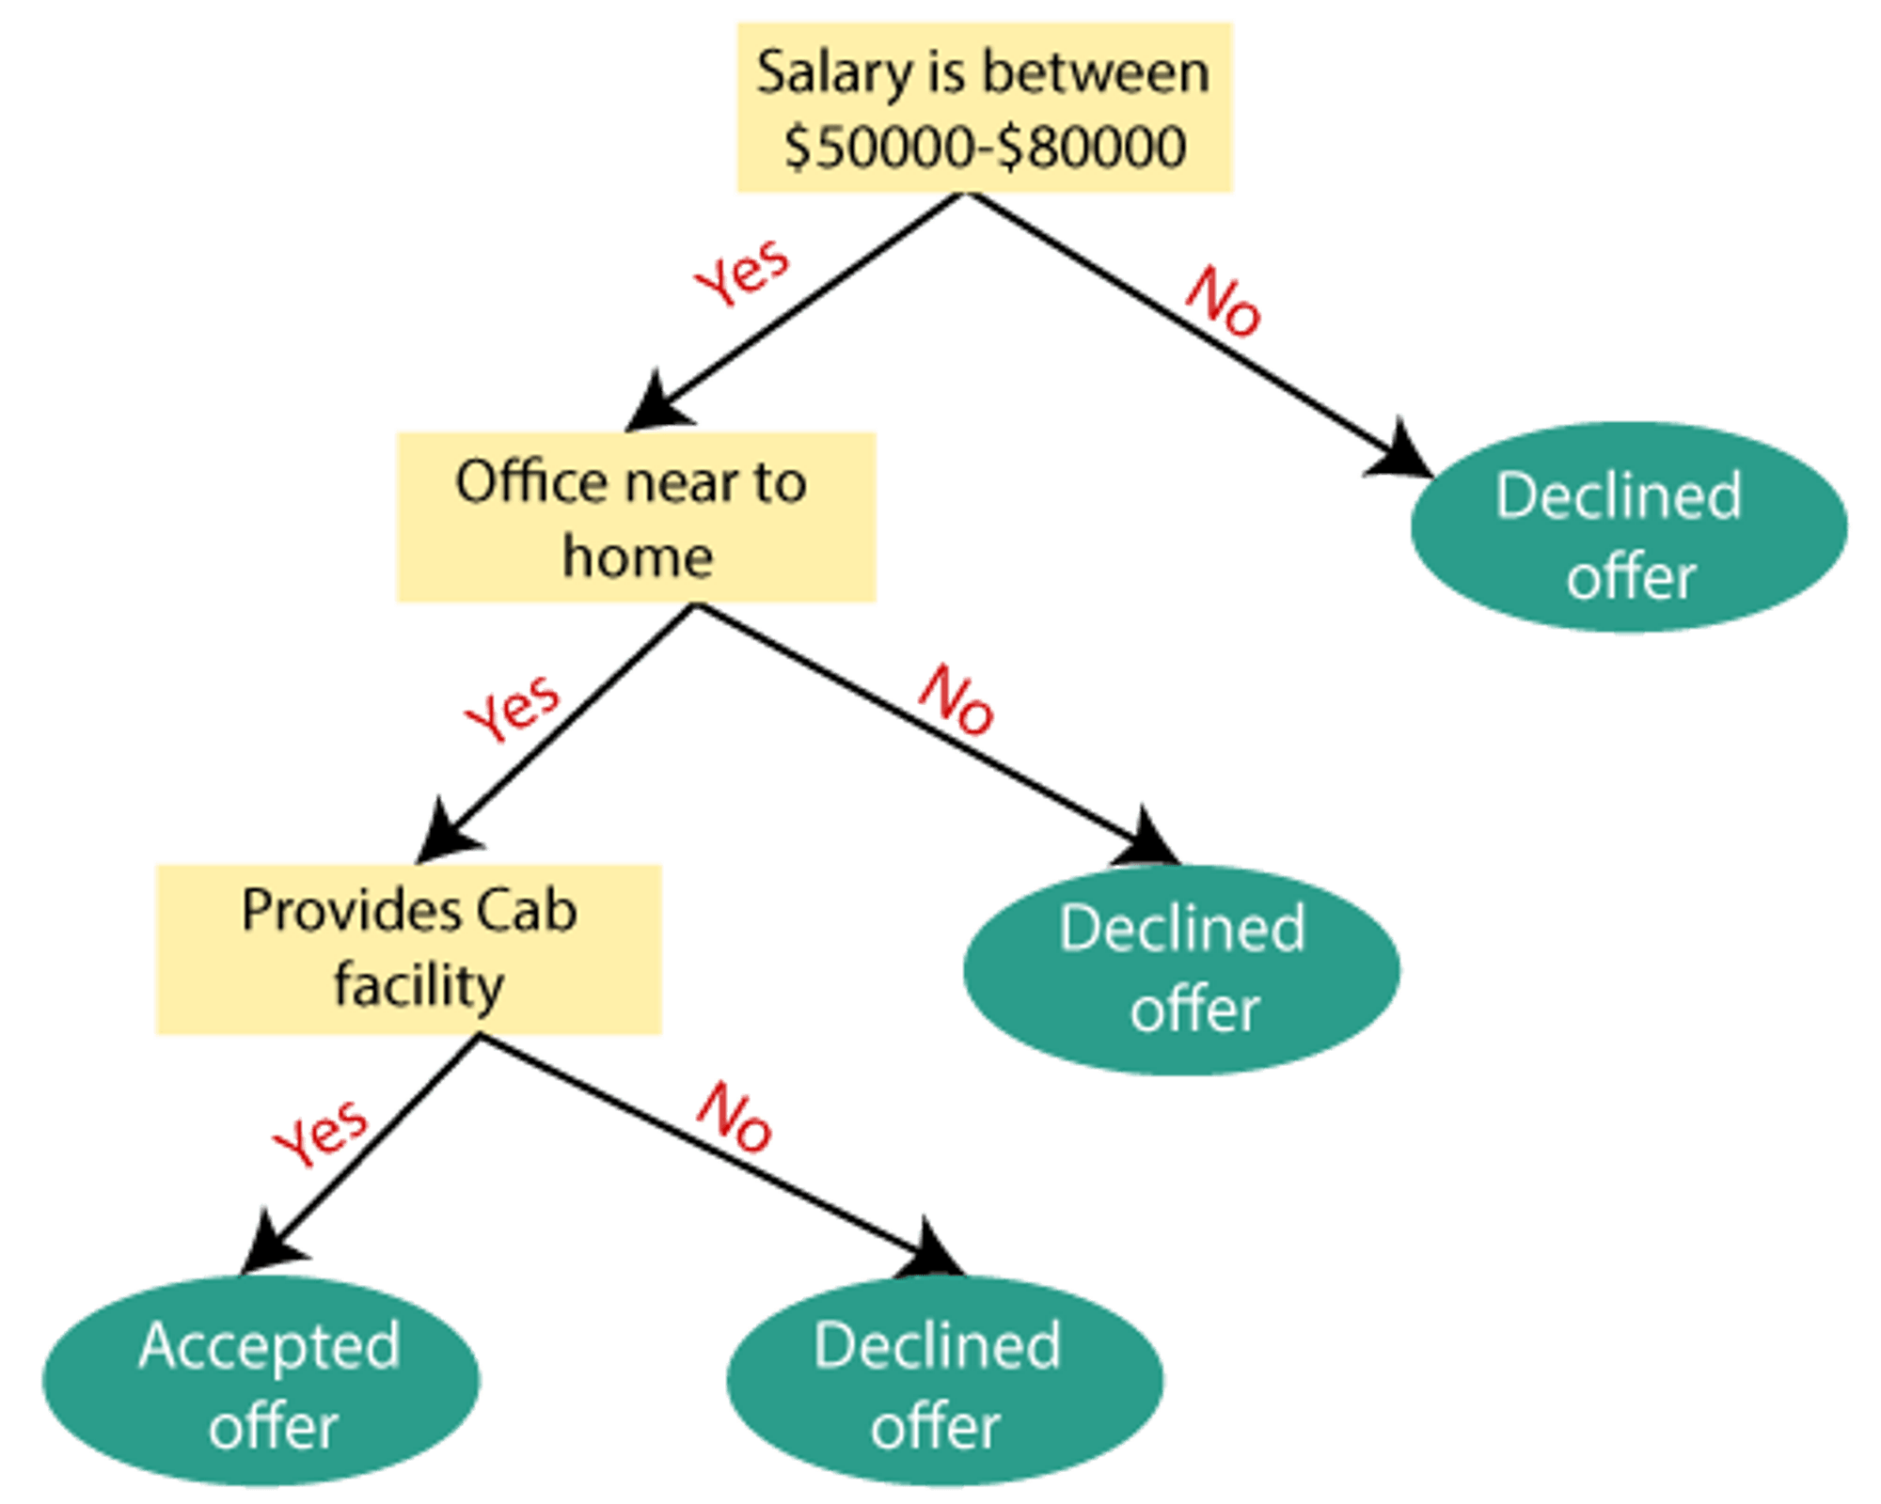
What is Decision Tree Algorithm?
A Decision Tree is a supervised machine learning algorithm used for both:
1 Classification (predicting categories)
2 Regression (predicting continuous values)
Terminologies:
Roote Node: starting point.
internal node represents a decision on a feature (attribute).
leaf node represents a final prediction

Slide 3
Working Overview
Anemia
Anemia | BP | Heart disease
Yes | No | Yes
Yes | Yes | No
No | Yes | Yes
No | No | No
Yes | No | No
Heart Disease
(yes) (no)
Heart Disease
(yes) (no)
BP
Heart Disease
(yes) (no)
Heart Disease
(yes) (no)

Slide 4
DT: solved example
Anemia | BP | Heart disease
Yes | No | Yes
Yes | Yes | No
No | Yes | Yes
No | No | No
Yes | No | No

Slide 5
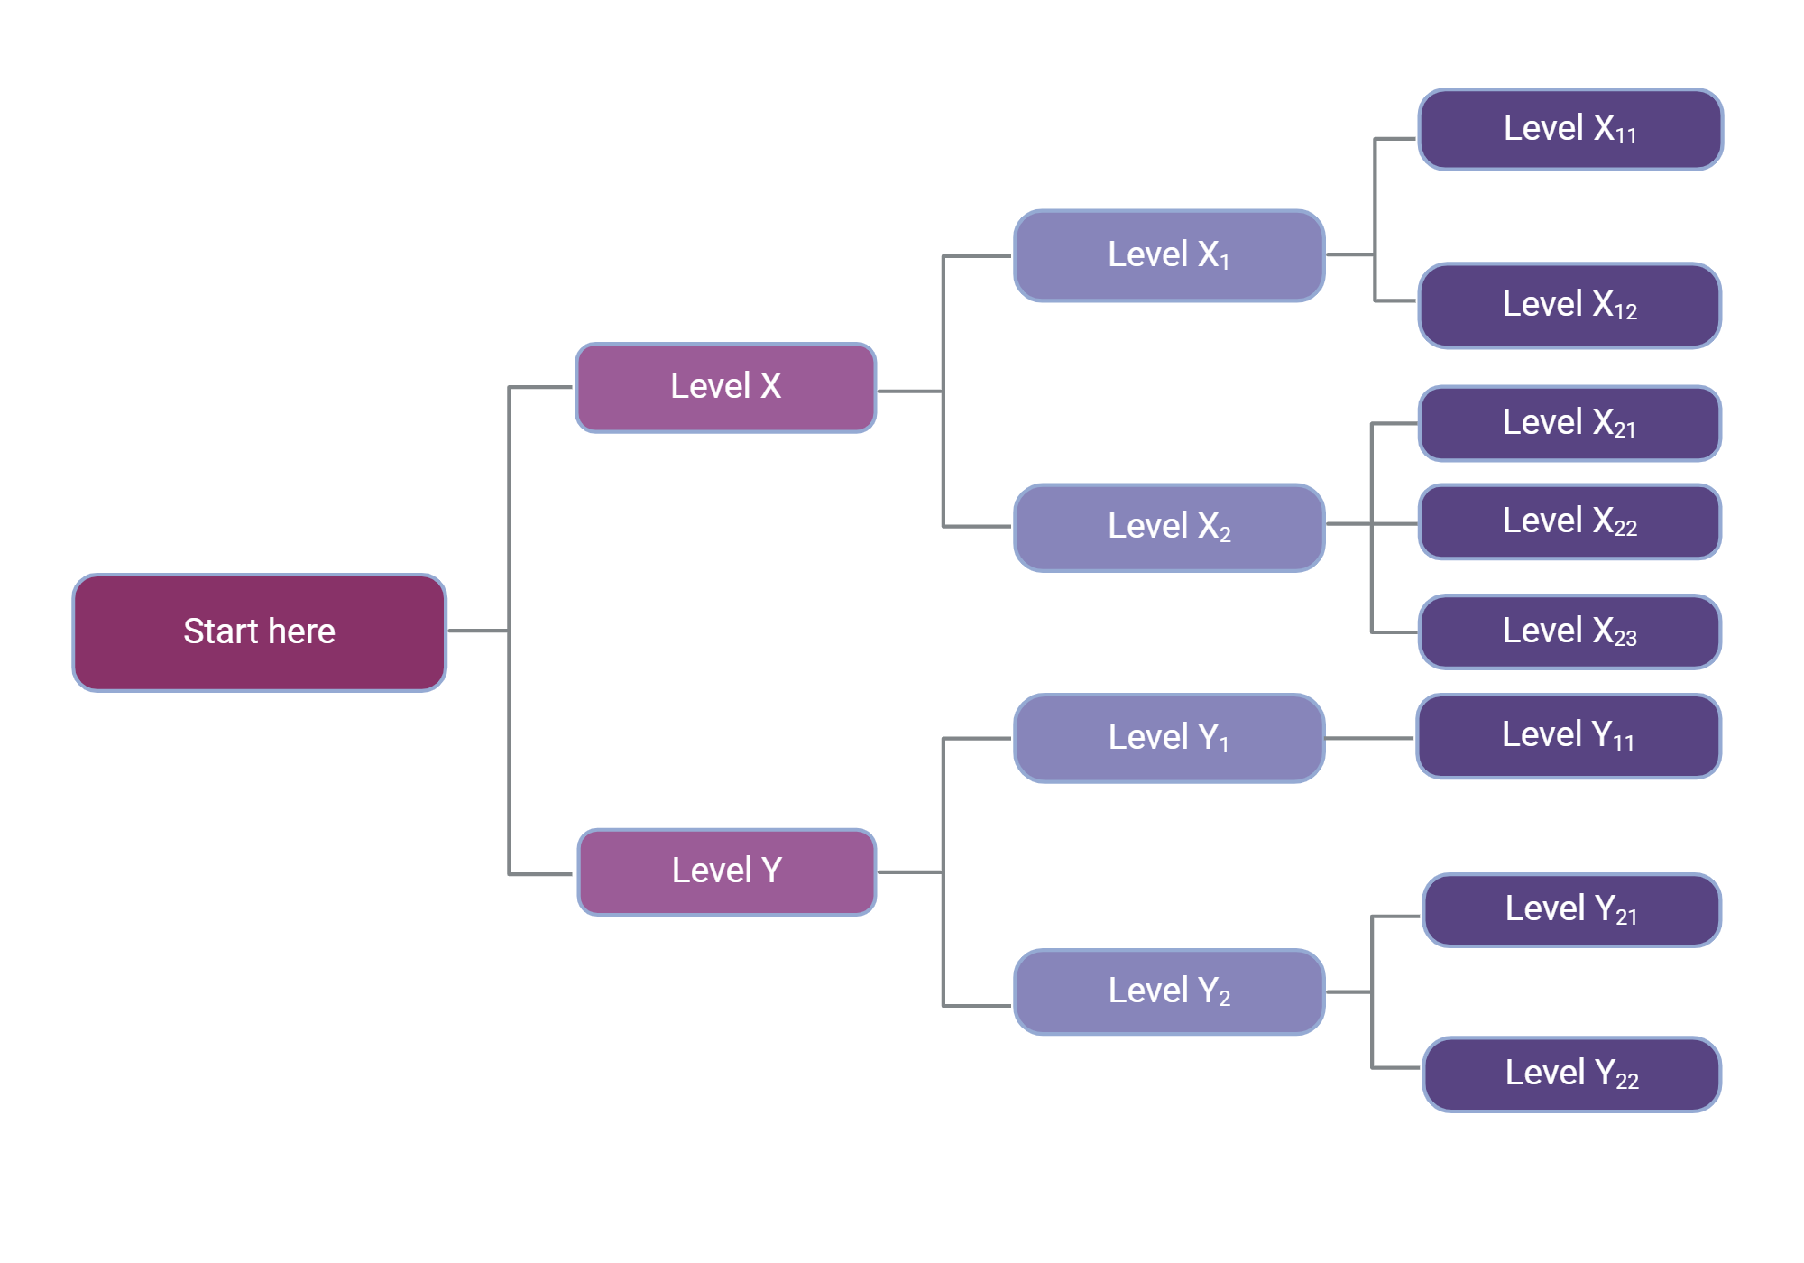
Geometrical Representation

Slide 6
Applications
Advantages of Decision Trees
Simple to understand & visualize No need for feature scaling (not sensitive to normalization) Handles both numerical & categorical data Works well for small datasets
Disadvantages
Prone to overfitting (too complex trees)
Applications
📌 Medical diagnosis 📌 Credit scoring 📌 Fraud detection 📌 Recommendation systems 📌 Predicting customer churn

Slide 7
Code Implementation
from sklearn.tree import DecisionTreeClassifier
# Create and train the Decision Tree
clf = DecisionTreeClassifier(criterion='gini', max_depth=3, random_state=42)
clf.fit(X_train, y_train)
prediction = clf.predict(X_test)

